Slide 1
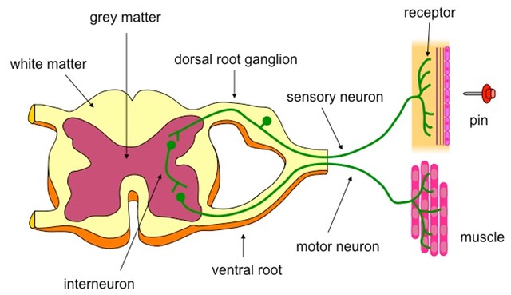
REFLEX in ACTION

Slide 2
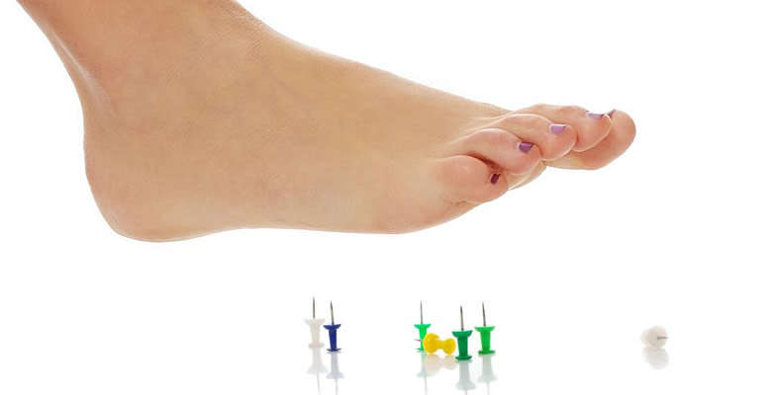
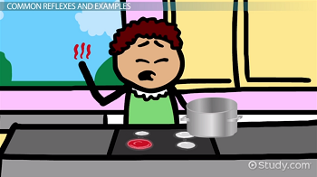
REFLEX ACTIONS
Reflex = automatic response to possible crisis.
E.g. You step on a burning coal. Your body jumps off it, even before your brain is aware of it.
Reflex arc (pathway) followed: Foot senses sharp unexpected pain. Impulse travels up sensory neuron to spinal cord. Nucleus in cell body sends this emergency impulse directly through connector neuron to motor neuron. This automatically contracts leg muscles to pull away from coal. Only then does message reach brain.

Slide 3
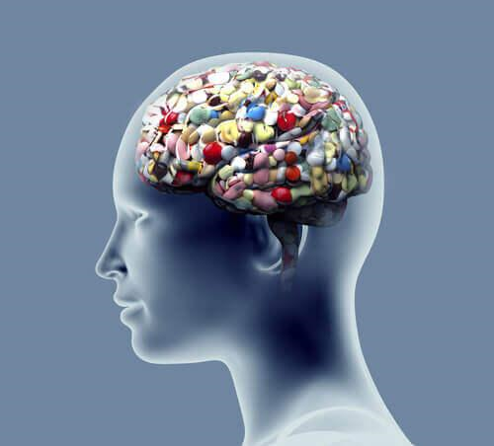
DISEASES, DRUGS & BRAINS
Alzheimer’s - brain’s neurons break down.
Multiple Sclerosis – body destroys myelin sheaths of its own neurons = short-circuits.
Stroke – brain neurons have shortage of blood.
Part of spinal cord cut – link broken between that part of body and brain. Paralysis.
Dagga: Brain damage in cerebrum.
Heroin (very addictive): Mental retardation.
Ecstasy: Kills brain cells and contact neurons.
Tik: Uncontrollably shaking hands, brain damage.

Slide 4
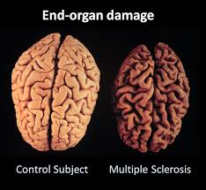
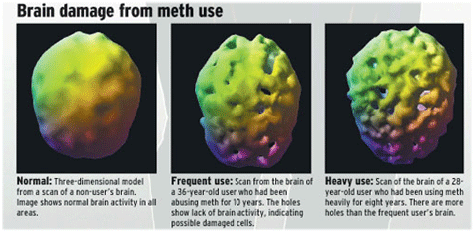
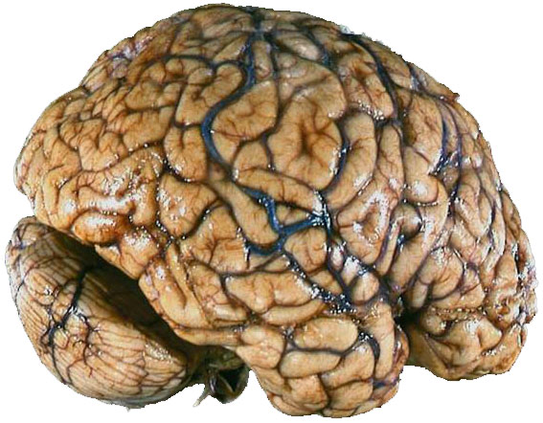
BRAIN after DRUGS

